Slide 1
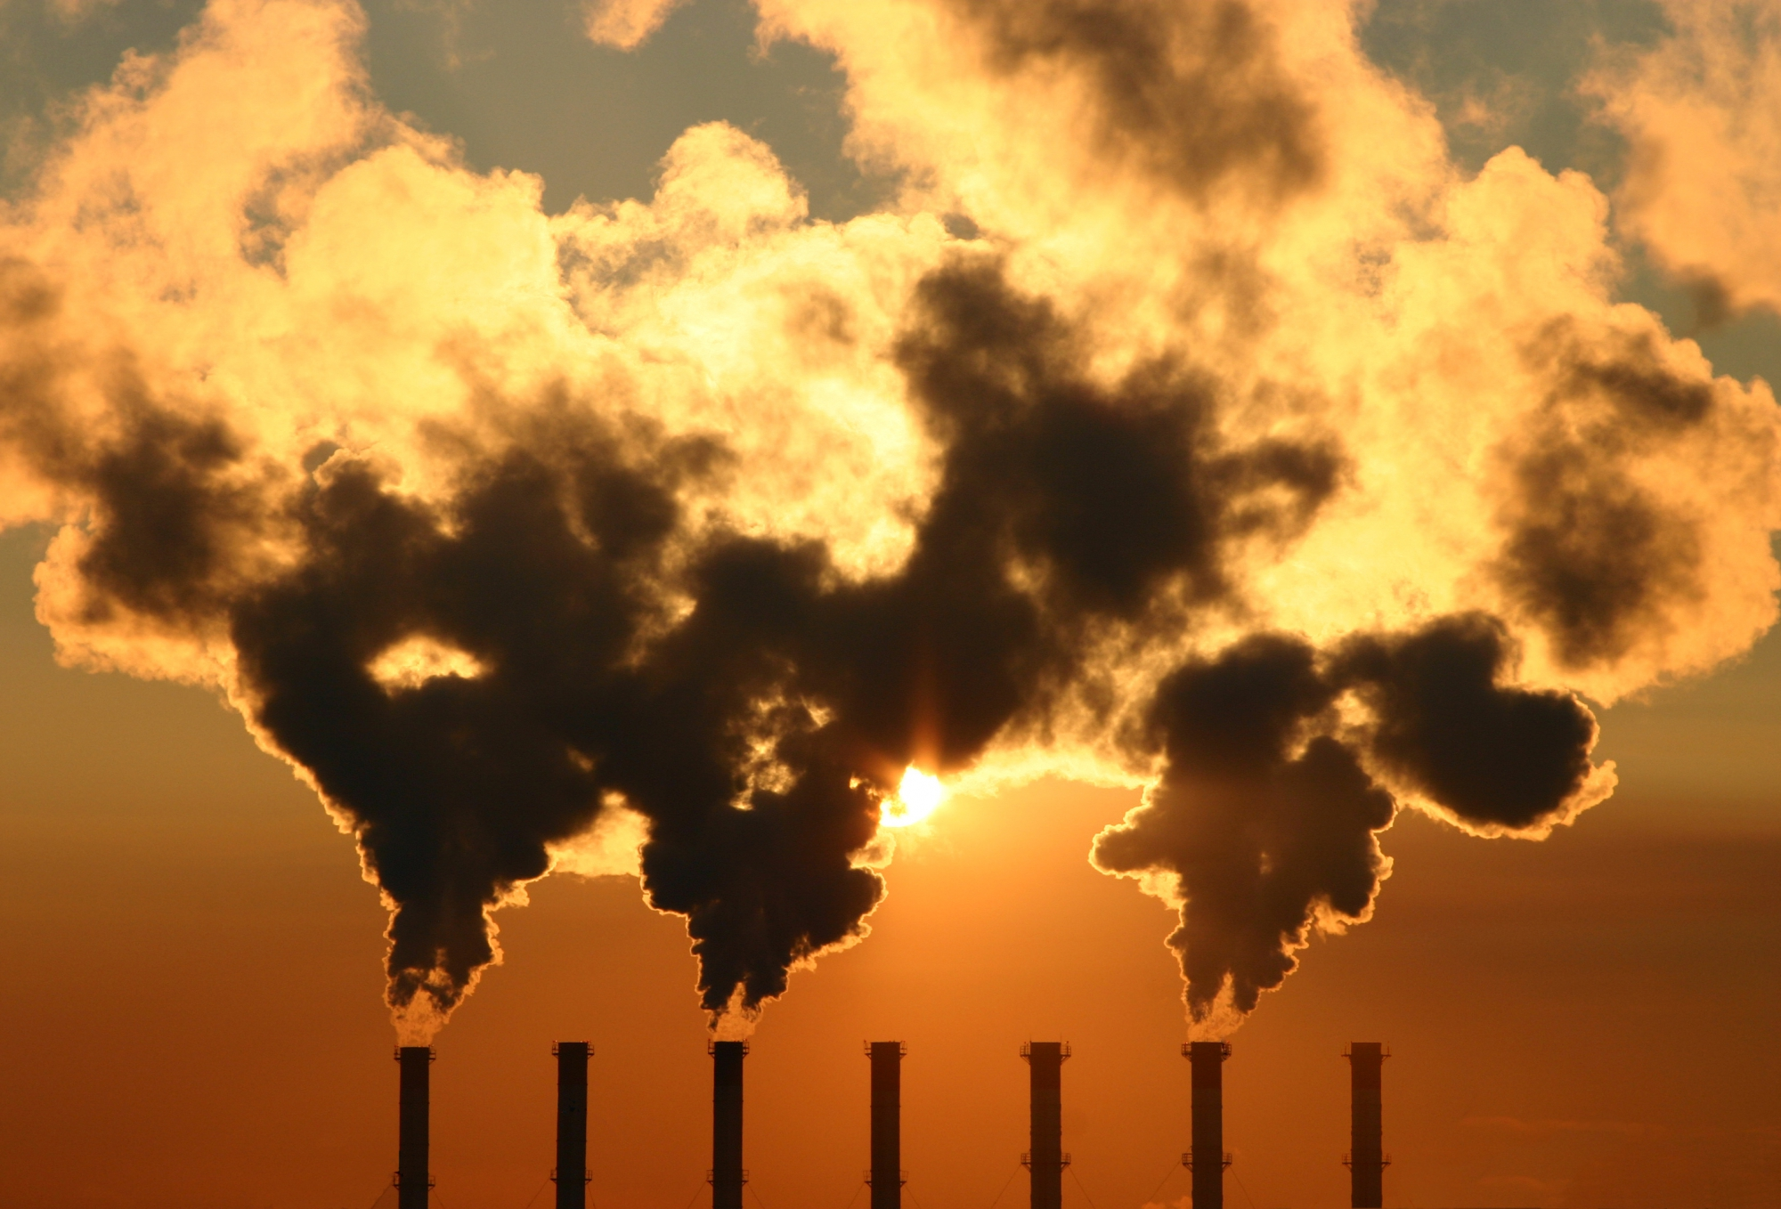
Air pollution and its consequences
by Andrey Ignatev

Slide 2
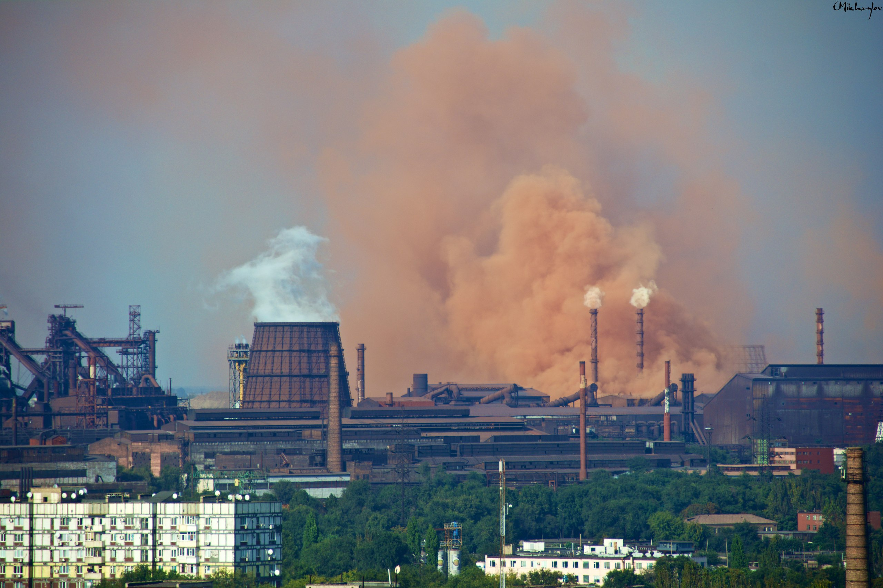
Pollutants
Carbon dioxide (CO2)
Sulfur oxides (SOx)
Nitrogen oxides (NOx)
Carbon monoxide (CO)
Volatile organic compounds (VOC)
Particulates (PM)
Chlorofluorocarbons (CFCs)
Ammonia (NH3)
Radioactive pollutants

Slide 3
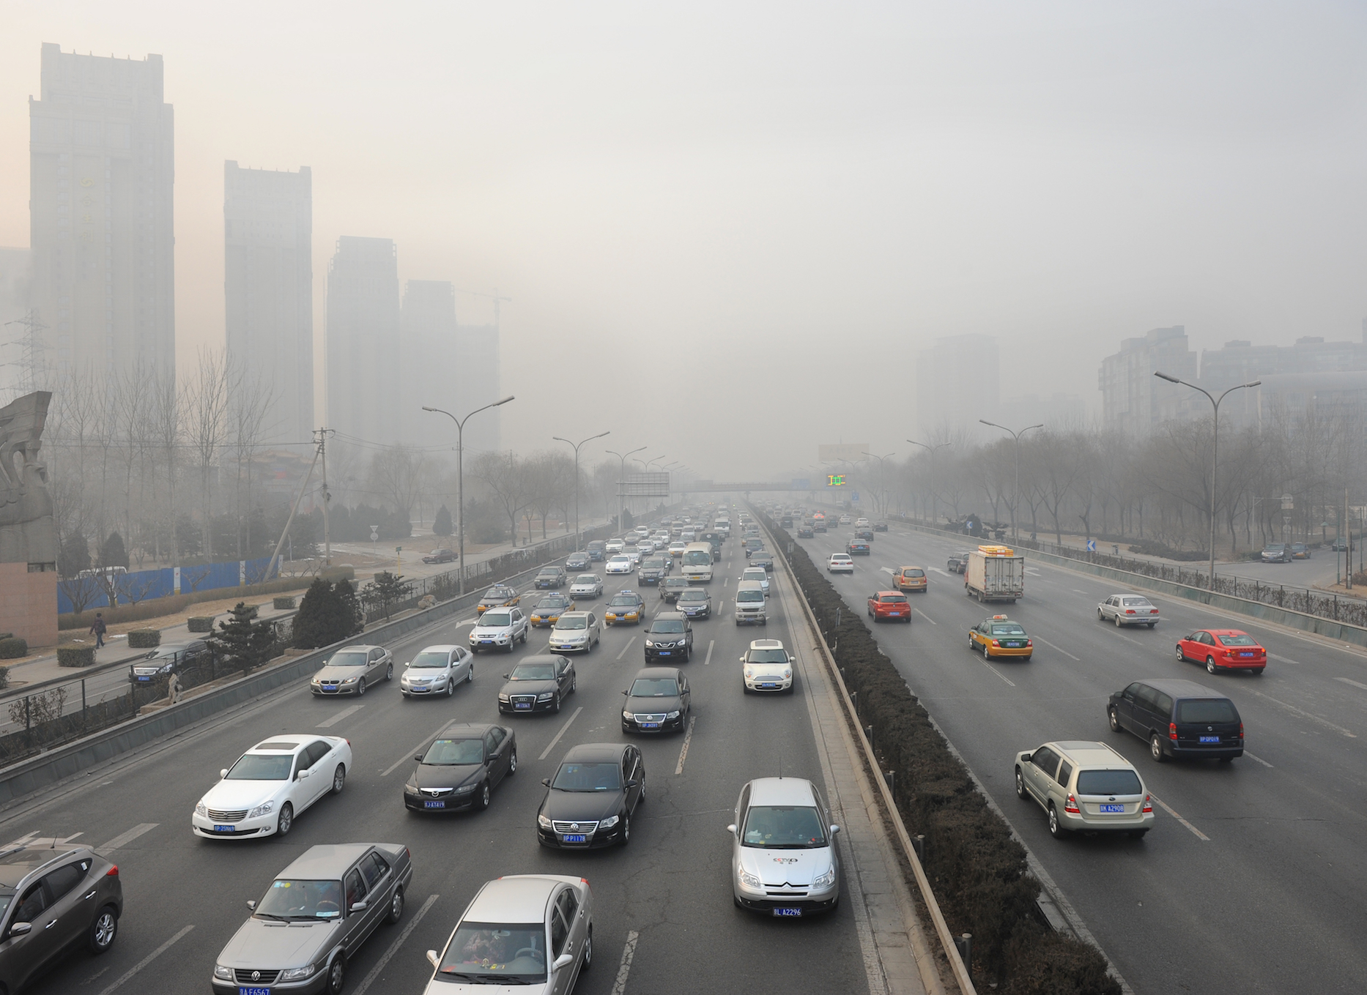
Sources
Anthropogenic (man-made) sources:
Stationary sources
Mobile sources
Solvent fumes
Waste deposition
Military resources
Natural sources:
Dust from natural sources
Methane
Radon
Vegetation VOCs
Volcanic activity

Slide 4
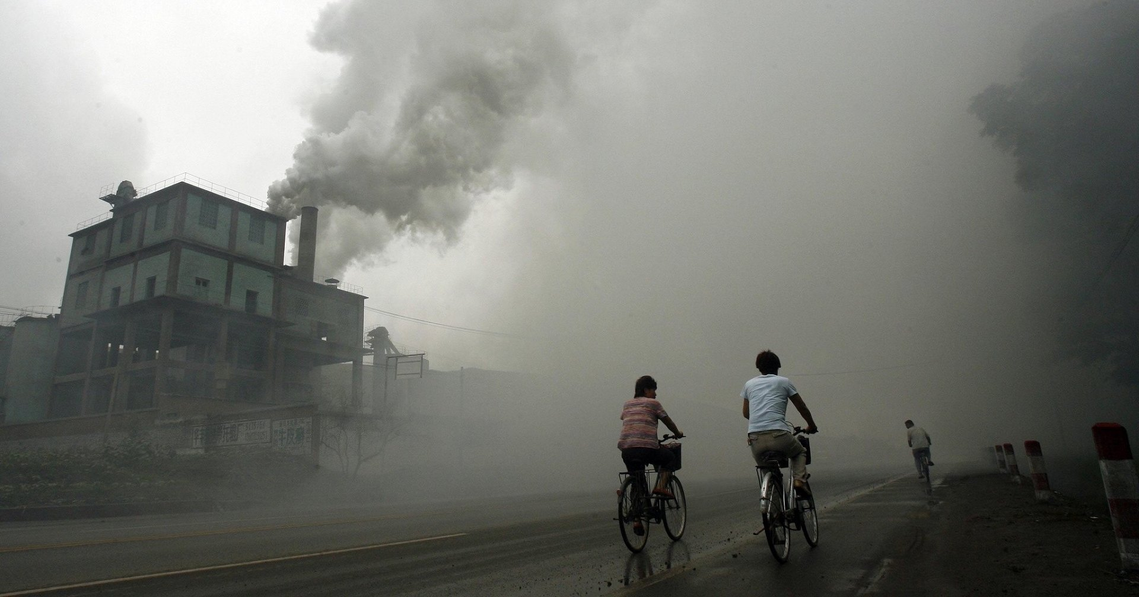
Health effects
Air pollution is a significant risk factor for a number of pollution-related diseases and health conditions including:
Respiratory infections
Heart disease
Chronic obstructive pulmonary disease (COPD)
Stroke
Lung cancer

Slide 5
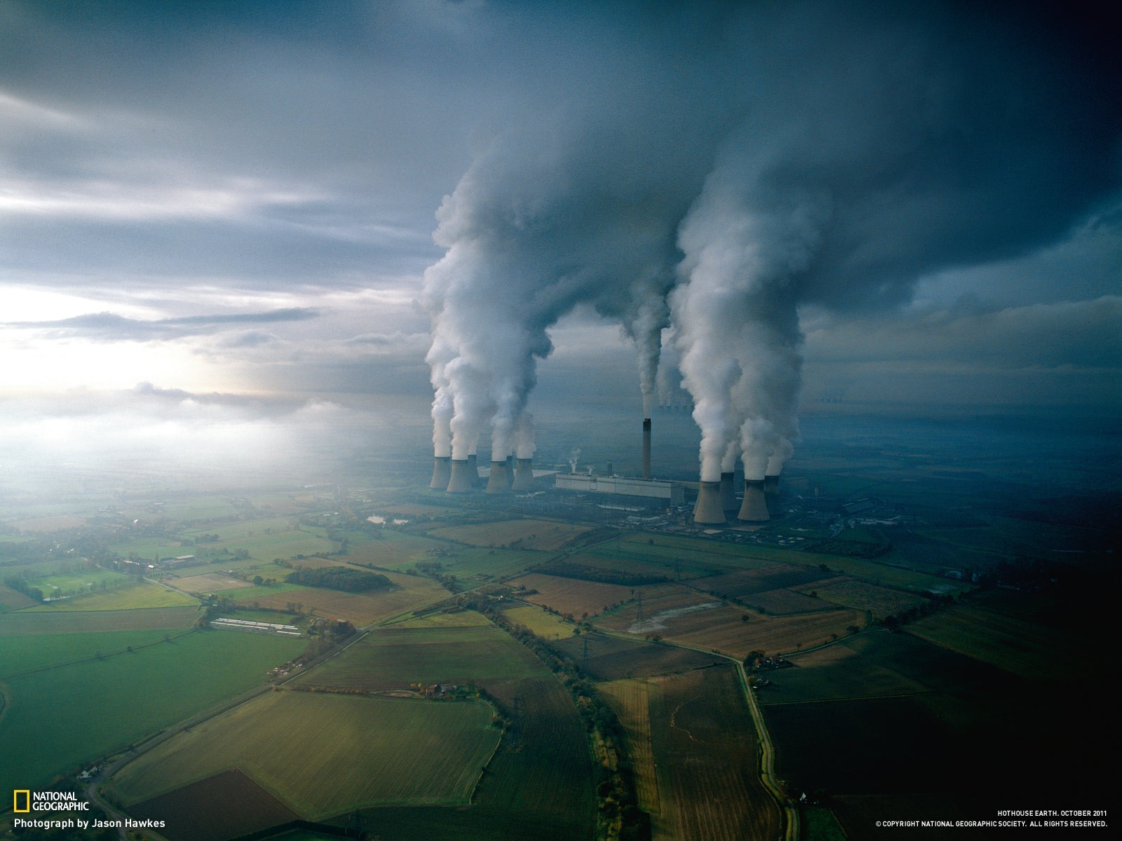
Economic effects
Air pollution costs the world economy at least $5 trillion per year as a result of productivity losses and degraded quality of life.

Slide 6
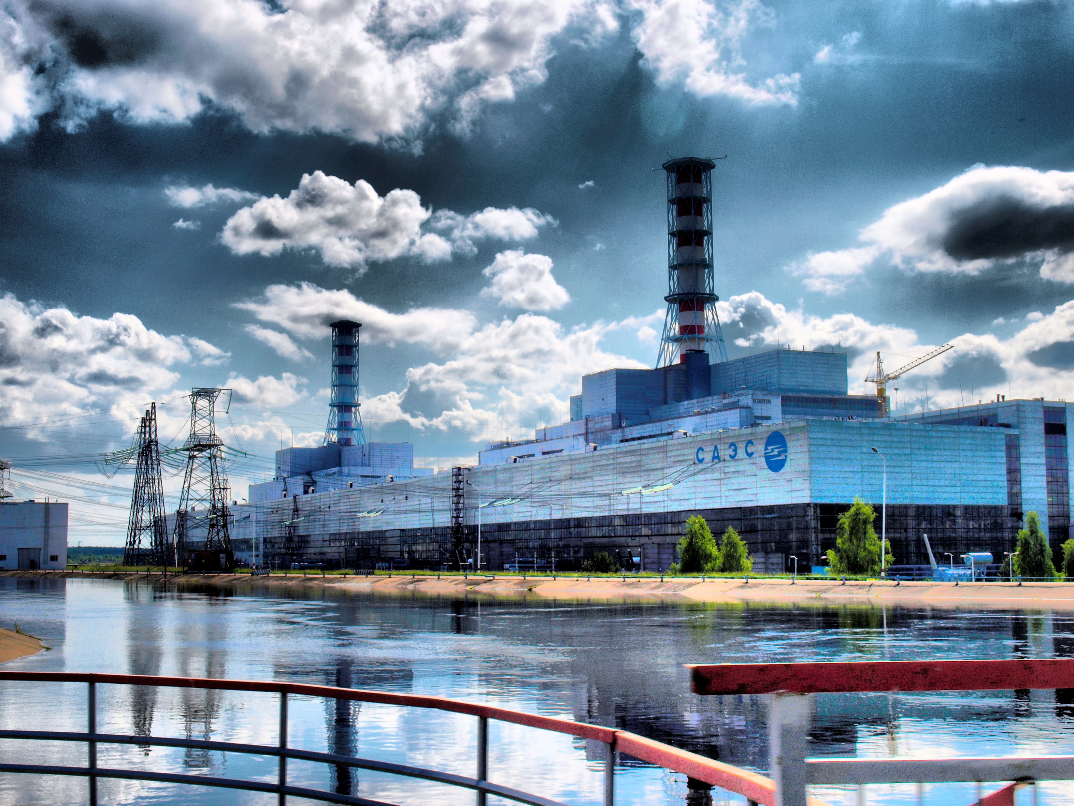
Ways to reduce air pollution
Aviation biofuel
Cleaner ship fuel
Heat pumps and seasonal thermal energy storages
Power generation from nuclear and renewables
Electric vehicles and public transport
Induced humidity and ventilation in enclosed spaces

Slide 7
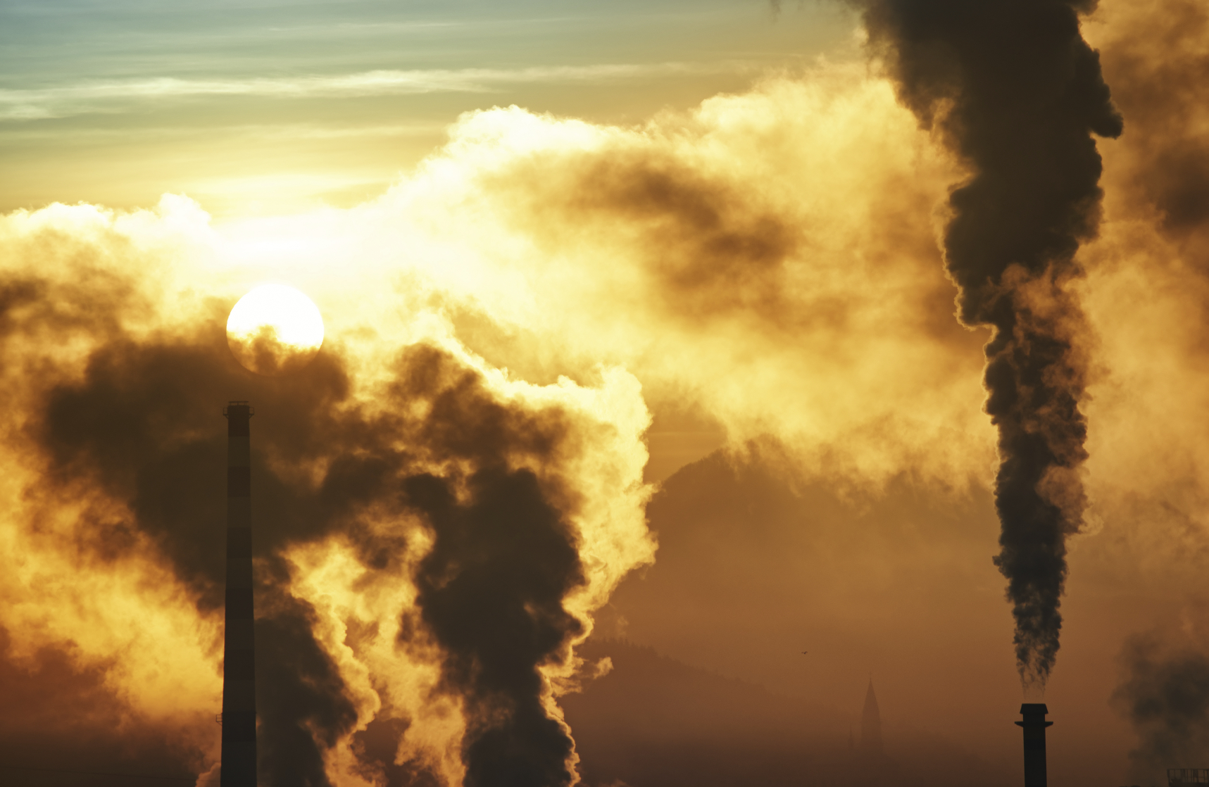
Thank you for the attention!
Materials of the following web-sites were used:
https://en.wikipedia.org

